Slide 1
SauceDemo Automation Testing using Selenium, Cucumber BDD, and Jenkins Framework
Under Guidance of Mrs. Vaishali Sonawane Mam.

Slide 2
Introduction :
SauceDemo is a test automation practice website designed for learning automation testing techniques with realworld e-commerce scenarios.
In this project, I have automated all core functionalities of SauceDemo using Selenium WebDriver with Java, Cucumber BDD framework, TestNG, and Jenkins CI/CD integration.
This automation framework helps in validating login scenarios, product inventory management, cart operations,
checkout process, and menu navigation using Behavior Driven Development (BDD) approach.
Automation reduces manual effort, provides faster test execution with continuous integration, and ensures the application workflow is working as expected with detailed reporting.

Slide 3
Member(s) of Team
Hemant Manohar Bhase(individual)

Slide 4
Responsibilities
I designed the complete automation framework using Page Object Model (POM) design pattern.
I wrote feature files using Gherkin language and step definitions using Cucumber BDD framework.
I implemented Jenkins CI/CD pipeline for automated test execution and reporting.
I executed all test scenarios and generated comprehensive HTML and PDF reports.
I documented defects found during automation testing and created test case documentation.

Slide 5
Overview
What is SauceDemo?
SauceDemo is a test automation practice website that simulates an e-commerce platform for buying products
Users can login, browse products, sort inventory, add items to cart, complete checkout process, and manage
account settings.
Why automate SauceDemo?
Automation ensures reliability of complete e-commerce workflow testing.
Helps validate multiple user scenarios with different credentials quickly.
Validates cart operations, checkout process, and error handling mechanisms.
BDD approach makes tests readable for both technical and non-technical stakeholders.

Slide 6
Modules
Module 1 : Login Functionality
Tested login with valid standard user credentials.
Tested login with locked out user and verified error message.
Tested login with invalid usernames and passwords.
Verified login with blank username and password fields.
Tested problem user login scenarios.
Module 2 : Product Inventory Management
Verified all products are displayed correctly on inventory page.
Tested product sorting by Name (A-Z and Z-A).
Tested product sorting by Price (Low to High and High to Low).
Validated product details and descriptions.
Module 3 : Shopping Cart Operations
Selected products from inventory and added to cart successfully.
Verified cart badge shows correct item count.
Tested removing individual products from cart.
Tested removing all products from cart.
Verified continue shopping functionality from cart page.
Notes:
Module 1: Signn in page
Checked all the functionalities on Sign in page which included personal info as email
address, password
Module 2: Women page
Checked all the functionalities on Women page which included item details, Quantity, Filters,compare button,Add to cart button,product info,grid,list button
Module 3: Tshirt page
Checked all the functionalities on T-Shirt page which included item details, Quantity, Filters,compare button,Add to cart button,product info,grid,list button
Module 4: All Buttons and Drop Down Arrow :
team checked if all the buttons and drop down arrows of different fields are functioning properly or not

Slide 7
Module 4 : Checkout Process
Navigated from cart to checkout page successfully.
Tested checkout with valid customer information (First Name, Last Name, Postal Code).
Tested checkout with missing required fields and verified error messages.
Verified order summary page with itemized product list.
Tested payment and shipping information display.
Verified total amount calculation including tax.
Module 5 : Order Completion
Completed order placement successfully.
Verified order completion message "Thank you for your order!".
Tested "Back to Products" button functionality.
Validated complete end-to-end checkout workflow.
Module 6 : Menu Navigation
Tested hamburger menu functionality.
Verified "All Items" navigation link.
Tested "About" page navigation.
Verified "Logout" functionality and return to login page.
Tested "Reset App State" functionality.

Slide 8
Defects
While automation testing, I discovered some defect(s):

Slide 9
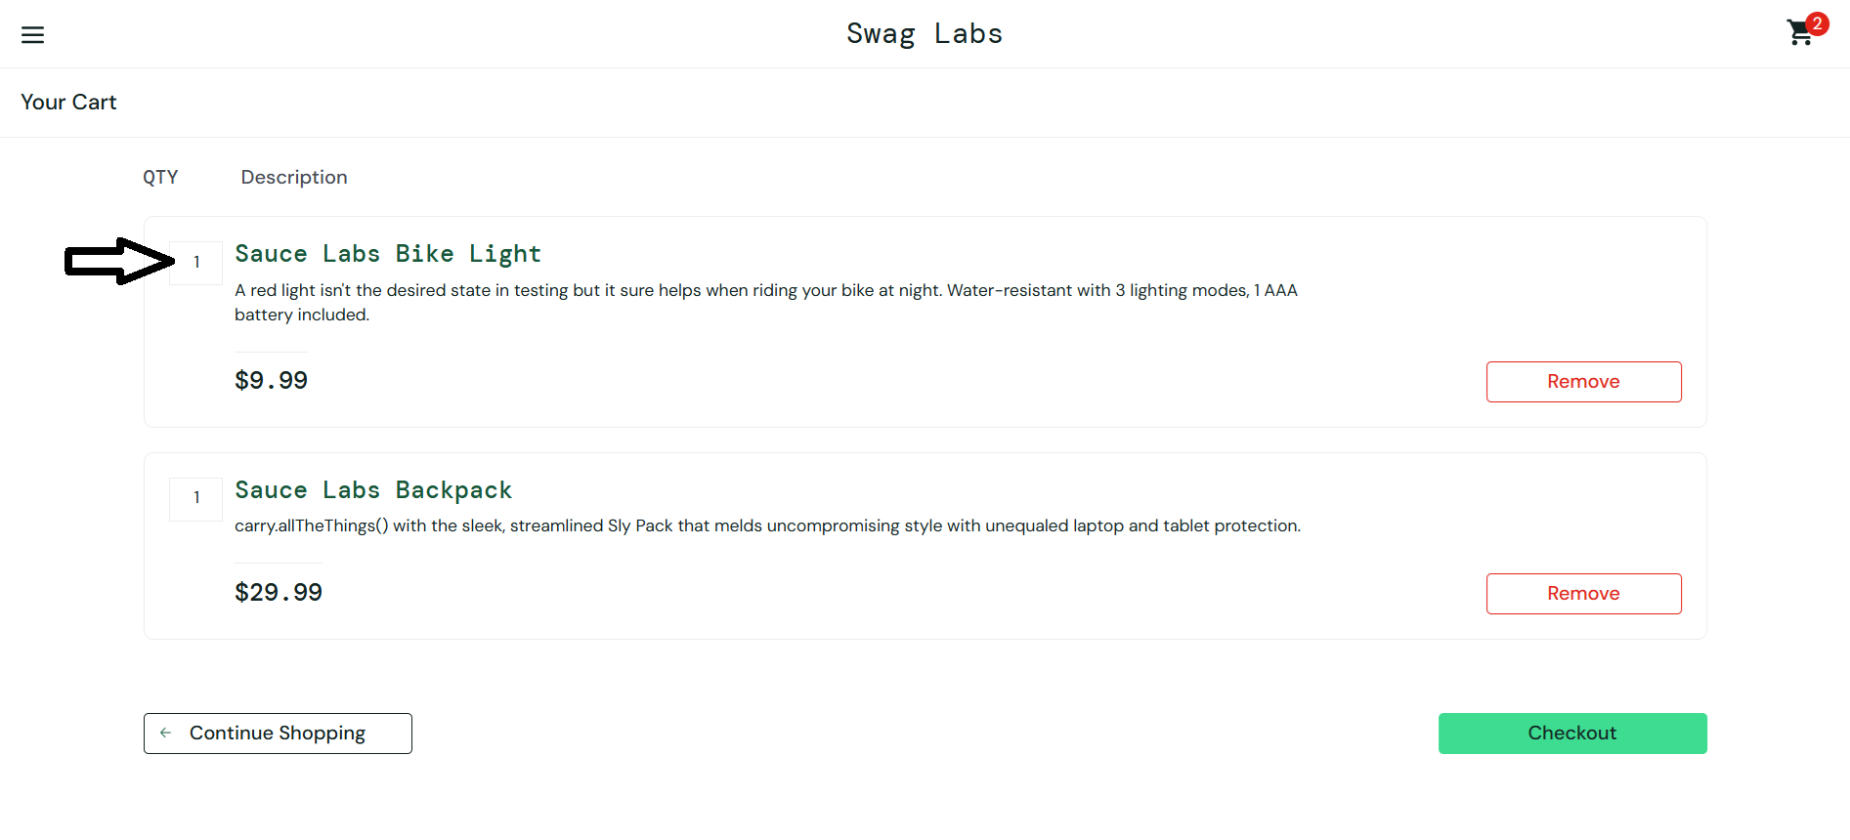
Defect identifier | DEF-001
Defect summary | No option to edit/remove quantity in cart page
 | Expected: User should be able to edit item quantity in cart
 | Actual: No quantity edit option available, only remove entire item
Test Id | TC_SD_012
Test case name | Update Cart Quantity
Module name | Cart Page
Reproducible | 1. Login to SauceDemo with valid credentials
 | 2. Add any product to cart
 | 3. Go to cart page
 | 4. Try to edit/change quantity of added item
Severity | Low
Priority | Medium
Raised by | Test Automation Team
Assigned to | Development Team
Date of assignment | 2025-09-03
Status | Open
Snapshots
Fixed by
Date of fixing
Approvals (Manager)

Slide 10
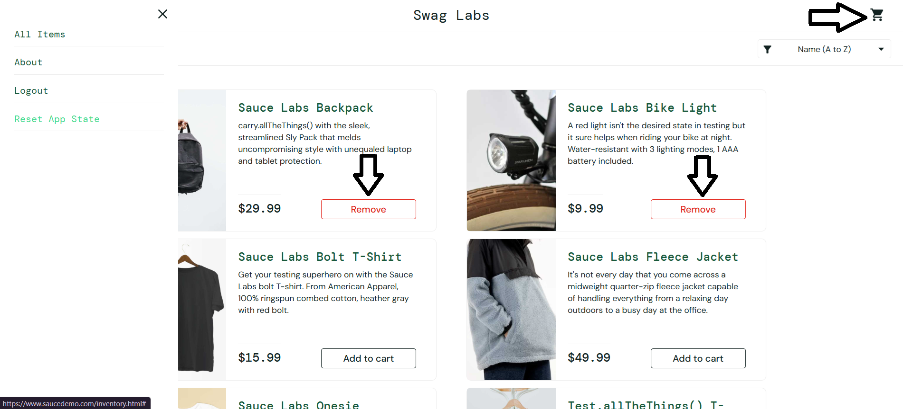
Defect identifier | DEF-002
Defect summary | Reset App State does not reset Add to Cart button state
 | Expected: After reset, all items should show "Add to Cart" button
 | Actual: Cart count resets to 0 but items still show "Remove" button
Test Id | TC_SD_026
Test case name | Verify Menu - Reset App State
Module name | Menu Navigation
Reproducible | 1. Login to SauceDemo with valid credentials
 | 2. Add one or more products to cart
 | 3. Open menu and click "Reset App State"
 | 4. Verify cart shows 0 items but product buttons still show "Remove"
Severity | High
Priority | Medium
Raised by | Test Automation Team
Assigned to | Development Team
Date of assignment | 2025-09-03
Status | Open
Snapshots
Fixed by
Date of fixing
Approvals (Manager)

Slide 11
Challenges
During testing I faced some challenges:
Synchronization issues due to dynamic page loading delays (resolved using explicit WebDriverWait and ExpectedConditions).
Element identification for similar products required unique locator strategies using CSS selectors and XPath.
Cross-browser compatibility testing required different WebDriver configurations and browser-specific handling.
Jenkins integration required proper Maven configuration and plugin setup for Cucumber reporting.
BDD scenario writing needed collaboration between business requirements and technical implementation.
Page Object Model implementation required careful design to maintain code reusability and maintainability.

Slide 12
Experience
This project gave me comprehensive practical learning of Selenium WebDriver with Cucumber BDD framework and Jenkins integration.
I gained expertise in Behavior Driven Development (BDD) approach for writing test scenarios in business-readable format.
Understanding Page Object Model design pattern improved my code organization and maintenance capabilities.
Implementing end-to-end automation framework from scratch enhanced my technical and analytical skills.
Defect identification and reporting during automation helped me understand quality assurance processes better.
Working with Maven build tool and dependency management improved my project setup and configuration skills.
This capstone project successfully demonstrated complete automation testing lifecycle with professional tools and frameworks.

Slide 13
Thank You!!!
Vaishali Mam For Guiding Us through out the Project.

